Slide 1
JavaScript - Team project “Black Jack”
Name: Team “EIRENE”
Sofia
2014

Slide 2
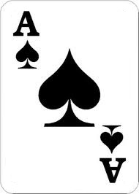

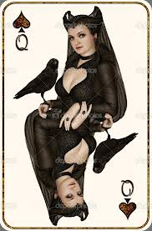
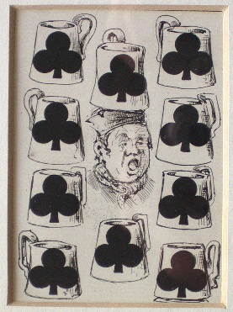
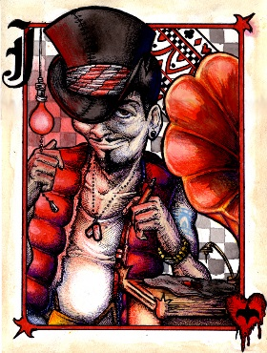
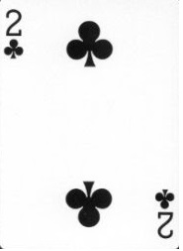


Team “EIRENE”
The Players:
Мартин Цеков
Васил Павлов
Живко Ангелов
Мария Николова
Анатоли Асенов
Никола Чакаров

Slide 3
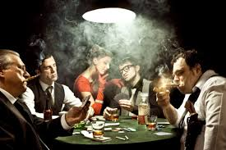

What is the game?
If (you ready
to play with us){
Object you = BLACKJACK.PLAYER;
}

Slide 4
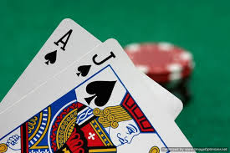
Blackjack, also known as twenty-one, is the most widely played casino banking game in the world. Blackjack is a comparing card game between a player and dealer, meaning that players compete against the dealer but not against any other players. It is played with one or more decks of 52 cards.

Slide 5

What is the game?
let see it….

